Slide 2
Topics
Future Value example from chapter 2
Basic PHP Syntax
Variables, Expressions, If Statements, Loops and some Predefined Functions in PHP
Using PHP.Net as a reference
Getting and validating data from the user
Creating a page that “posts back” to itself.

Slide 7
Syntax Basics
The next set of slides come directly from the textbook author and contain “snippets” of php code that illustrate php syntax.
I included them for your information but I’m going to skip them in favor of looking at the example in the textbook and using that as a way of talking about syntax of the language.
I’m going to “scroll ahead” to the Future Value application on slide 58 . This is the first part of lab 2.

Slide 9
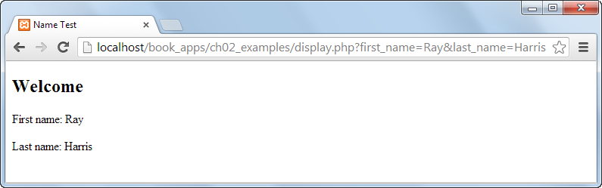

Slide 20
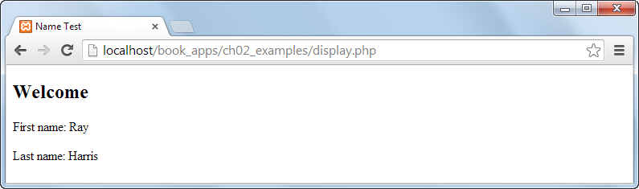

Slide 23
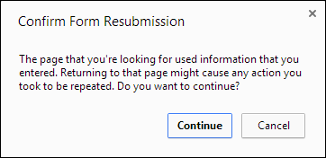

Slide 38
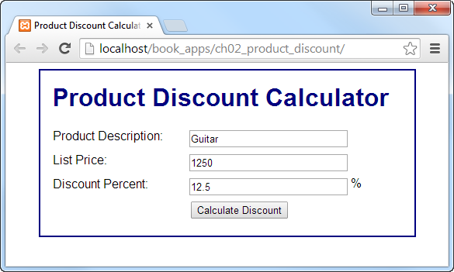

Slide 39
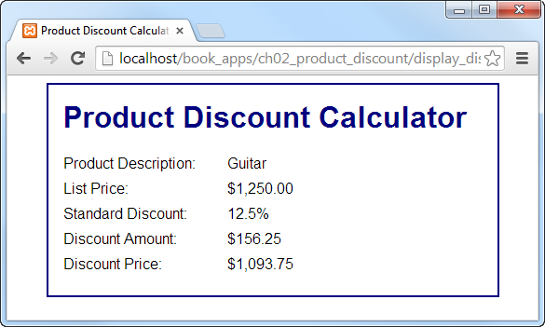

Slide 56
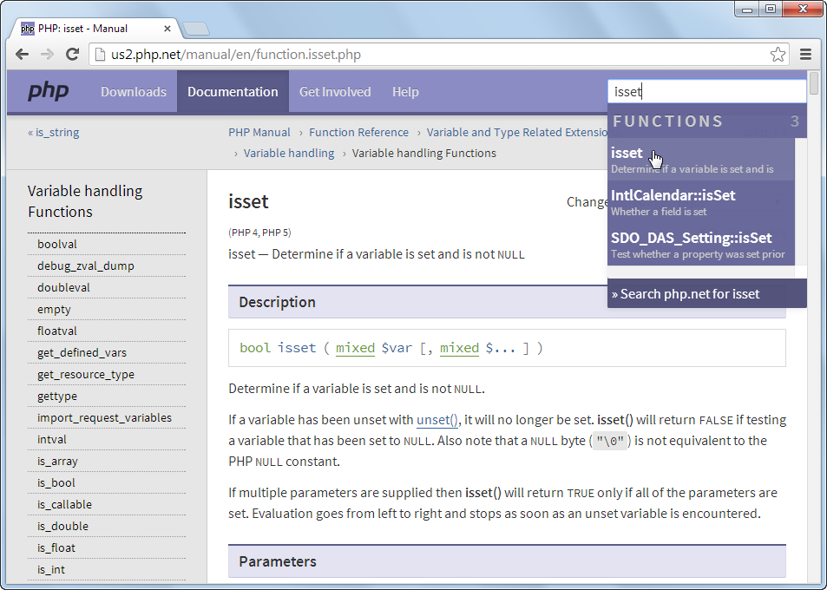

Slide 58
Future Value App – Version 1
Future Value example in chapter 2 calculates the value of an investment at some point in the future (assuming that it’s earning interest!)
The code for the version in the textbook is in the starting files
The explanation of the application begins on page 80 in the text.
I’m going to start by running the application with both valid and invalid input
When I think we all understand what it does, we’ll look at the code together.
Eventually I’ll give you a chance to work on exercise 2-2 in the text.

Slide 59
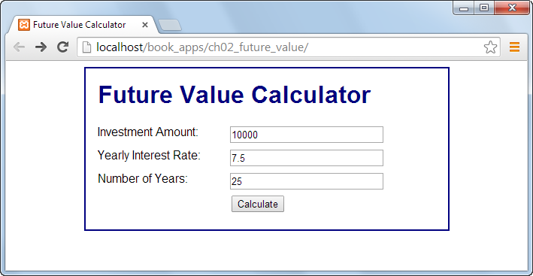

Slide 60
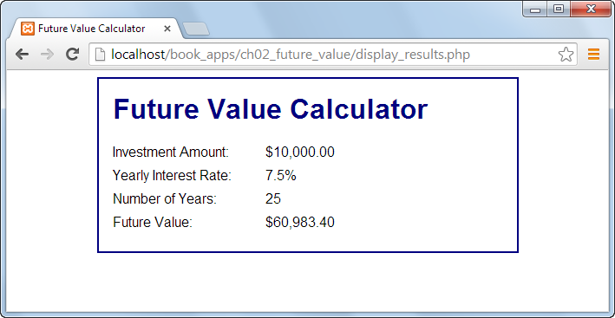

Slide 61
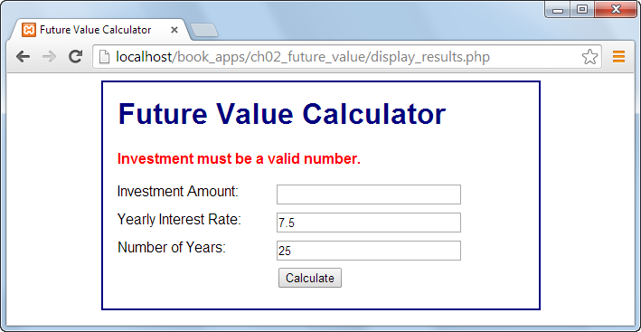

Slide 68
Lab 2
Lab 2 description in moodle is more detailed.
Exercise 2 – 2 on page 93 and 94 of the text
Parts 1 – 3 ask you to “play” with the application
Parts 4 and 5 ask you to make sure the interest rate is less than 15%
Part 6 asks you to add the date at the bottom of the page.
Convert the application from part 1 to a “1 page” application.
I’ve given you a sample file to use as an example in the Future Value One Page folder in the starting files.
Let’s look at that together now.

Slide 69
Lab 2
Mortgage Calculator application
I’ll run the app so you can see what it does.
I’ve given you starting files. You add the php’
There are LOTS of web sites out there where you can verify that your payment calculation is correct.
The formula you need is:
P = ( r * A ) / ( 1 - (1+r)^{-N}) Where,
P = Payment Amount
A = Loan Amount
r = Monthly Interest Rate
N = Number of Monthly Payments

Slide 70
Lab 2
Convert the application from part 3 to a “1 page” application.
Add a loan amortization schedule to part 3 OR part 4.
If you don’t know what a loan amortization schedule is, or if you want to verify your calculations, here’s a site that contains an amortization schedule
http://www.bankrate.com/partners/sem/mortgage-calculator-rates.aspx

Slide 71
Lab 2
I’m going to have you do 1 and 3 now. If you finish those, you could also start 5.
Next class period I’ll show you how to convert part 1 to an application that “posts back” to itself or a 1 page application.
At that point you’ll be ready for 2 and 4.
You can add the amortization schedule to your solution for 3 or 4.
As you complete each part, keep a copy of the previous part. That way you’ll have examples of both 1 and 2 page applications that you’ve written yourself.

Slide 72
Pages that “Post Back”
Many of you noticed that in the previous examples there are essentially 2 versions of the html form
In order to improve on that I’m going to
Separate the form from the processing. I’ll actually put the form in one file and the bulk of the code in another file.
This is the beginning of a design pattern that’s generally referred to as model-view-controller or MVC.
Model generally refers to code. View generally refers to the UI displayed to the user. Controller is generally the logic that controls it all. The controller sets up the model, does any processing and displays the view.
Add an if statement to the controller to check to see if the user has submitted any data for processing
The same page is “requested twice” – the first time the user comes to the page and when the user clicks the submit button.

Slide 73
The View
<!DOCTYPE html>
<html>
<head>
<title>Future Value Calculator</title>
<link rel="stylesheet" type="text/css" href="main.css">
</head>
<body>
<main>
<h1>Future Value Calculator</h1>
<?php if (!empty($error_message)) { ?>
<p class="error"><?php echo htmlspecialchars($error_message); ?></p>
<?php } ?>

Slide 74
The View
<form action="index.php" method="post">
<div id="data">
<label>Investment Amount:</label>
<input type="text" name="investment"
value="<?php echo htmlspecialchars($investment); ?>">
<br>
<label>Yearly Interest Rate:</label>
<input type="text" name="interest_rate"
value="<?php echo htmlspecialchars($interest_rate); ?>">
<br>
<label>Number of Years:</label>
<input type="text" name="years"
value="<?php echo htmlspecialchars($years); ?>">
<br>
<label>Future Value:</label>
<span><?php echo $future_value_f; ?></span>
<br>
</div>
<div id="buttons">
<label>&nbsp;</label>
<input type="submit" value="Calculate"><br>
</div>
</form>
</main>
</body>
</html>

Slide 75
The View
<div id="buttons">
<label>&nbsp;</label>
<input type="submit" value="Calculate"><br>
</div>
</form>
</main>
</body>
</html>

Slide 76
The Controller
<?php
//set default value of variables for initial page load
if (!isset($investment)) { $investment = ''; }
f (!isset($interest_rate)) { $interest_rate = ''; }
if (!isset($years)) { $years = ''; }
if (!isset($future_value_f)) { $future_value_f = ''; }
if (count($_POST) > 0)
{
// get the data from the form
$investment = filter_input(INPUT_POST, 'investment', FILTER_VALIDATE_FLOAT); …
// validate investment …
// if everything is ok, do the calculations …
}
// show the form on the page. It will either display empty strings or the appropriate values include("view.php");?>

Slide 77
Lab 2
Convert your solution to part 1 in the lab to a “1 page” application that posts back to itself.
The view should be identical to mine except for the date.
The controller has a little bit of extra valication code.
Be careful with the placement of the if statement and {}!
Convert your solution to part 3.
The easiest solution to part 5 uses the 2 page version to add the loan amortization schedule.
If you decide to make it a one page application:
The controller should create a 2 d array, each row is a line in the amortization schedule
The view will contain a foreach loop that displays the schedule.

Slide 78
Next Time
You’ll get to practice all of this again with several other applications in the next 2 labs.
Begin to skim chapters 7 – 11, 13 and 15.
Reading Quizzes 3 and 4.
Labs 3 and 4
Lab 5 will add Ajax calls to several of the problems that you did in previous labs.
Quiz 1

